Slide 1
Course Outline
Introduction and Algorithm Analysis (Ch. 2)
Hash Tables: dictionary data structure (Ch. 5)
Heaps: priority queue data structures (Ch. 6)
Balanced Search Trees: general search structures (Ch. 4.1-4.5)
Union-Find data structure (Ch. 8.1–8.5)
Graphs: Representations and basic algorithms
  Topological Sort (Ch. 9.1-9.2)
  Minimum spanning trees (Ch. 9.5)
  Shortest-path algorithms (Ch. 9.3.2)
B-Trees: External-Memory data structures (Ch. 4.7)
kD-Trees: Multi-Dimensional data structures (Ch. 12.6)
Misc.: Streaming data, randomization

Slide 2
Priority Queue ADT
In many applications, we need a scheduler
  A program that decides which job to run next
Often the scheduler a simple FIFO queue
  As in bank tellers, DMV, grocery stores etc
But often a more sophisticated policy needed
  Routers or switches use priorities on data packets
  File transfers vs. streaming video latency requirement
  Processors use job priorities
Priority Queue is a more refined form of such a scheduler.

Slide 3
Priority Queue ADT
A set of elements with priorities, or keys
Basic operations:
  insert (element)
  element = deleteMin (or deleteMax)
No find operation!
Sometimes also:
  increaseKey (element, amount)
  decreaseKey (element, amount)
  remove (element)
  newQueue = union (oldQueue1, oldQueue2)

Slide 4
Priority Queue: implementations
Unordered linked list
  insert is O(1), deleteMin is O(n)
Ordered linked list
  deleteMin is O(1), insert is O(n)
Balanced binary search tree
  insert, deleteMin are O(log n)
  increaseKey, decreaseKey, remove are O(log n)
  union is O(n)
Most implementations are based on heaps . . .

Slide 5
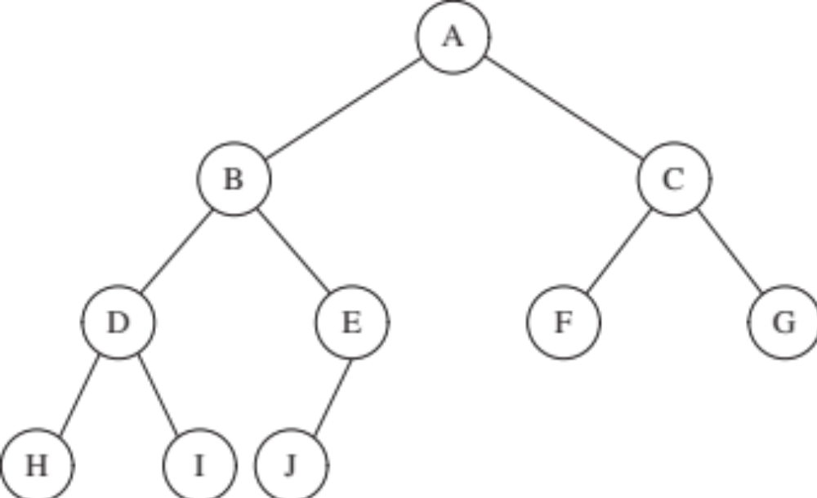
Heap-ordered Binary trees
Tree Structure: A complete binary tree
  One element per node
  Only vacancies are at the bottom, to the right
  Tree filled level by level.
  Such a tree with n nodes has height O(log n)

Slide 6
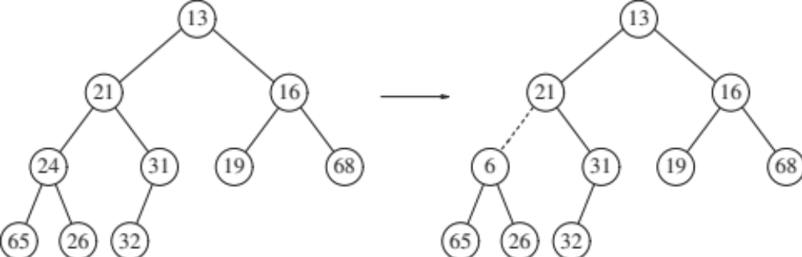
Heap-ordered Binary trees
Heap Property
  One element per node
  key(parent) < key(child) at all nodes everywhere
  Therefore, min key is at the root
  Which of the following has the heap property?

Slide 7
Basic Heap Operations
  percolateUp
    used for decreaseKey, insert
percolateUp (e):
while key(e) < key(parent(e))
swap e with its parent

Slide 8
Basic Heap Operations
  percolateDown
    used for increaseKey, deleteMin
percolateDown (e):
while key(e) > key(some child of e)
swap e with its smallest child

Slide 9
Decrease or Increase Key ( element, amount )
Must know where the element is; no find!
DecreaseKey
  key(element) = key(element) – amount
  percolateUp (element)
IncreaseKey
key(element) = key(element) + amount
percolateDown (element)

Slide 10
insert ( element )
add element as a new leaf
  (in a binary heap, new leaf goes at end of array)
percolateUp (element)
O( tree height ) = O(log n) for binary heap

Slide 11
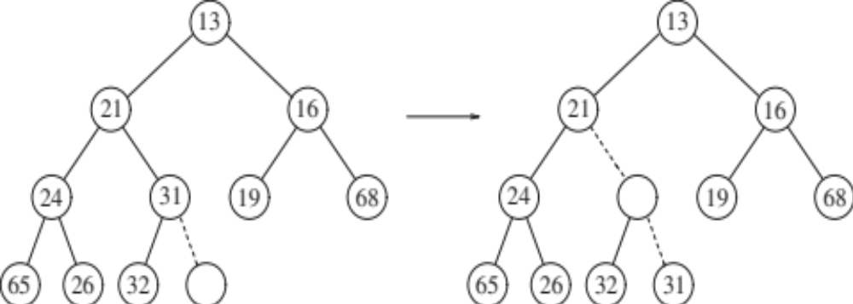
Binary Heap Examples
Insert 14: add new leaf, then percolateUp
Finish the insert operation on this example.

Slide 12
deleteMin
element to be returned is at the root
to delete it from heap:
swap root with some leaf
  (in a binary heap, the last leaf in the array)
percolateDown (new root)
O( tree height ) = O(log n) for binary heap

Slide 13
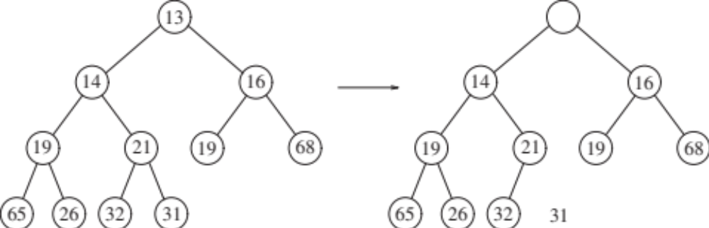
Binary Heap Examples
deleteMin. Hole at the root.
Put last element in it, percolateDown.

Slide 14
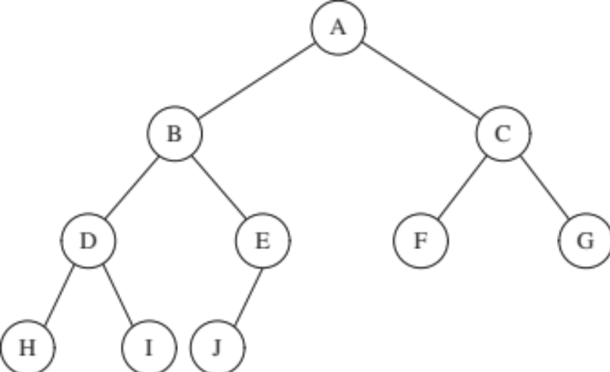
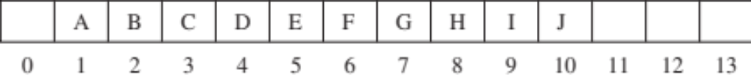
Array Representation of Binary Heaps
Heap best visualized as a tree, but easier to implement as an array
Index arithmetic to compute positions of parent and children, instead of pointers.

Slide 15
Short cut for perfectly balanced binary heaps
Array implementation
Lchild = 2·parent
Rchild = 2·parent+1
1
parent = ⎣child/2⎦
2
3
4
5
6
7
8
9

Slide 16
Heapsort and buildHeap
A naïve method for sorting with a heap.
O(N log N)
Improvement: Build the whole heap at once
  Start with the array in arbitrary order
  Then fix it with the following routine
for (int i=0; i<n; i++)
H.insert(a[i]);
for (int i=0; i<n; i++)
H.deleteMin(x);
a[i] = x;
template <class Comparable>
BinaryHeap<Comparable>::buildHeap( )
for (int i=currentSize/2; i>0; i--)
percolateDown(i);

Slide 17
buildHeap
Fix the bottom level
Fix the next to bottom level
Fix the top level

Slide 18
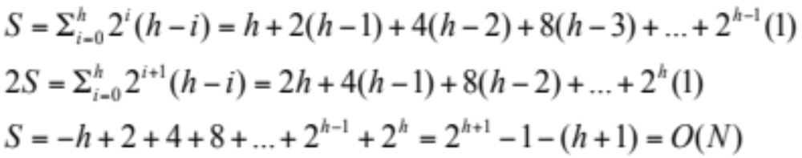
Analysis of buildHeap
2
15
4
10
11
5
9
13
3
6
1
12
16
17
8
14
18
7
For each i, the cost is the height of the subtree at i
For perfect binary trees of height h, sum:

Slide 19
Summary of binary heap operations
insert: O(log n)
deleteMin: O(log n)
increaseKey: O(log n)
decreaseKey: O(log n)
remove: O(log n)
buildHeap: O(n)
advantage: simple array representation, no pointers
disadvantage: union is still O(n)

Slide 20
Some Applications and Extensions of Binary Heap
Heap Sort
Graph algorithms (Shortest Paths, MST)
Event driven simulation
Tracking top K items in a stream of data
d-ary Heaps:
  Insert O(log_{d} n)
  deleteMin O(d log_{d} n)
  Optimize value of d for insert/deleteMin

Slide 21
Leftist heaps: Mergeable Heaps
Binary Heaps great for insert and deleteMin but do not support merge operation
Leftist Heap is a priority queue data structure that also supports merge of two heaps in O(log n) time.
Leftist heaps introduce an elegant idea even if you never use merging.
There are several ways to define the height of a node.
In order to achieve their merge property, leftist heaps use NPL (null path length), a seemingly arbitrary definition, whose intuition will become clear later.

Slide 22
Leftist heaps
NPL(X) : length of shortest path from X to a null pointer
Leftist heap : heap-ordered binary tree in which NPL(leftchild(X)) >= NPLl(rightchild(X)) for every node X.
Therefore, npl(X) = length of the right path from X
also, NPL(root) ≤ log(N+1)
  proof: show by induction that
  NPL(root) = r implies tree has at least 2^{r} - 1 nodes

Slide 23
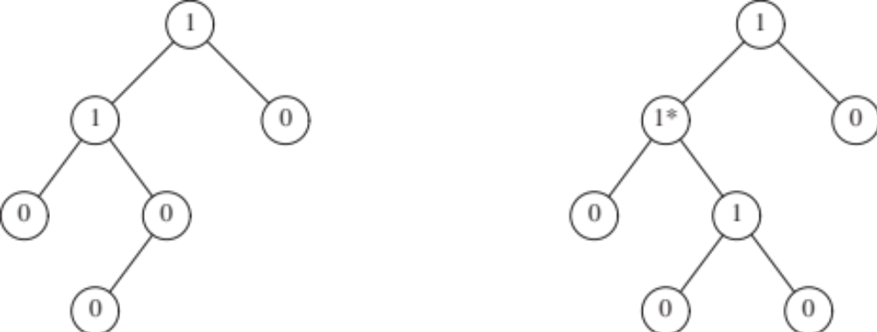
Leftist heaps
NPL(X) : length of shortest path from X to a null pointer
Two examples. Which one is a valid Leftist Heap?

Slide 24
Leftist heaps
NPL(root) ≤ log(N+1)
  proof: show by induction that
  NPL(root) = r implies tree has at least 2^{r} - 1 nodes
  The key operation in Leftist Heaps is Merge.
  Given two leftist heaps, H₁ and H₂, merge them into a single leftist heap in O(log n) time.

Slide 25
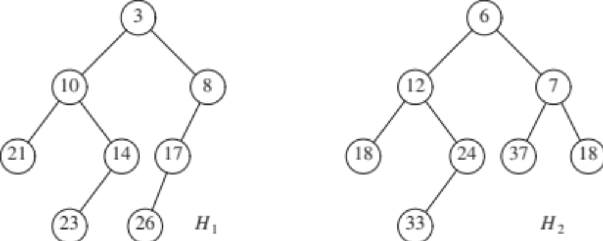
Leftist heaps: Merge
Let H₁ and H₂ be two heaps to be merged
  Assume root key of H₁ <= root key of H₂
  Recursively merge H₂ with right child of H₁, and make the result the new right child of H₁
  Swap the left and right children of H₁ to restore the leftist property, if necessary

Slide 26
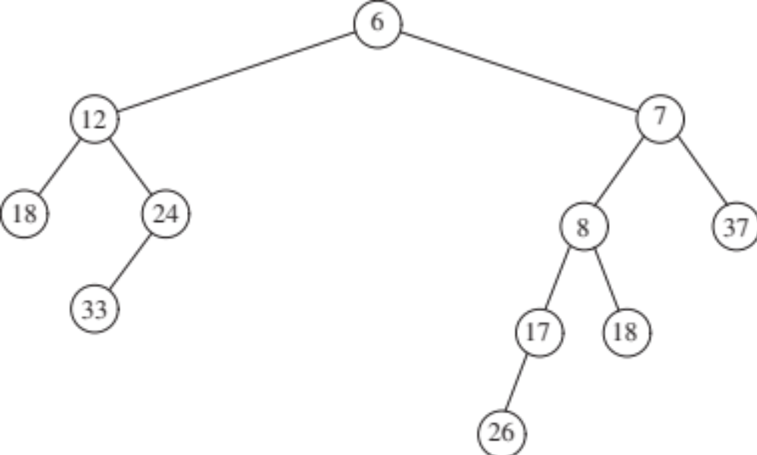
Leftist heaps: Merge
Result of merging H₂ with right child of H₁

Slide 27
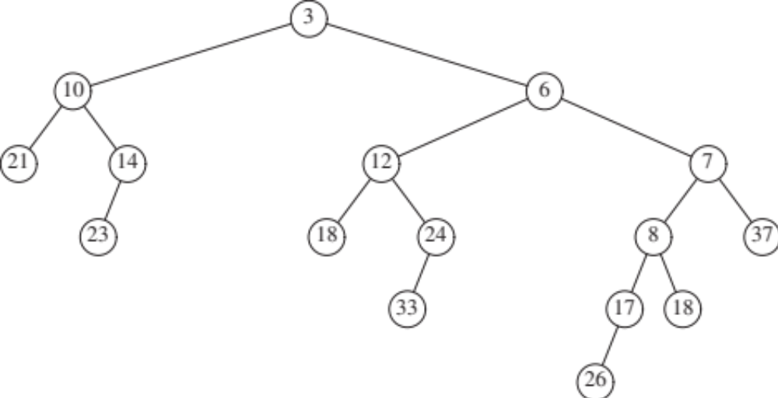
Leftist heaps: Merge
Make the result the new right child of H₁

Slide 28
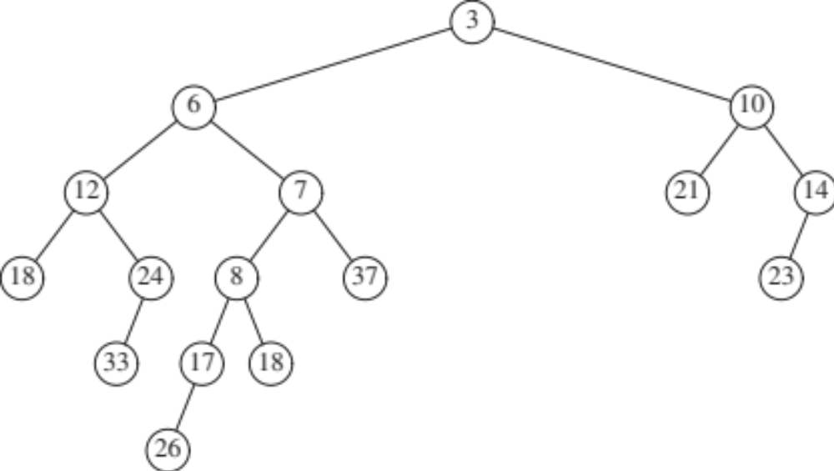
Leftist heaps: Merge
Because of leftist violation at root, swap the children
This is the final outcome

Slide 29
Leftist heaps: Operations
Insert: create a single node heap, and merge
deleteMin: delete root, and merge the children
Each operation takes O(log n) because root’s NPL bound

Slide 30
Merging leftist heaps
Merge(t1, t2)
if t1.empty() then return t2;
if t2.empty() then return t1;
if (t1.key > t2.key) then swap(t1, t2);
t1.right = Merge(t1.right, t2);
if npl(t1.right) > npl(t1.left) then
swap(t1.left, t1.right);
npl(t1) = npl(t1.right) + 1;
return t1
insert: merge with a new 1-node heap
deleteMin: delete root, merge the two subtrees
All in worst-case O(log n) time

Slide 31
Other priority queue implementations
skew heaps
  like leftist heaps, but no balance condition
  always swap children of root after merge
  amortized (not per-operation) time bounds
binomial queues
  binomial queue = collection of heap-ordered
  “binomial trees”, each with size a power of 2
  merge looks just like adding integers in base 2
  very flexible set of operations
Fibonacci heaps
  variation of binomial queues
  decreaseKey runs in O(1) amortized time,
  other operations in O(log n) amortized time

